Slide 1

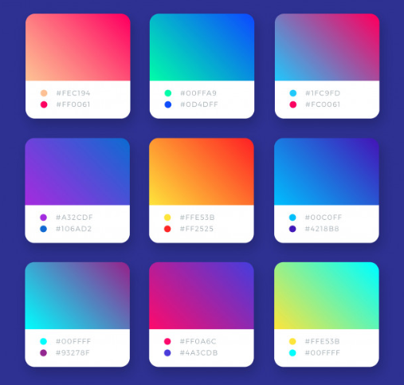

Tackling the Technical Interview Series:
User Interface
Please mark your attendance by placing a check mark by your name via the link provided in the chat.

Slide 2
Purpose & Objectives
Complete a UI Challenge in a short period of time by breaking down the UI Process and then creating a product.
Define the process of how to build a new product using UI principals
Create a user flow diagram, a wireframe and a prototype

Slide 3

UI Challenge
Create a signup page, modal, form, or app screen related to signing up for something. It could be for a volunteer event, contest registration, a giveaway, or anything you can image. Upload it to Dribble using #CareerServices

Slide 4

Brainstorming & Sketching
Brainstorming and Sketching gives you a good idea of how you want the project to turn out.
Your project does not have end up like your sketch, feel free to adjust while your designing.
It’s okay to use a paper and pencil to sketch and brainstorm. Make sure that you save all of your sketches and add them to dribble.

Slide 5
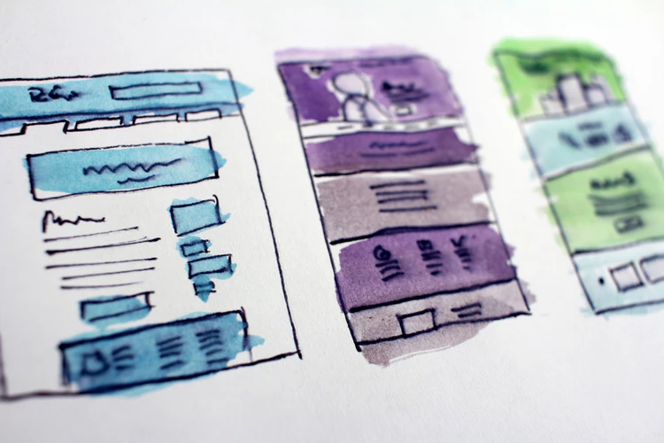

Slide 6

Student Activity
Take 15 minutes to brainstorm and sketch out and brainstorm a plan of action. If you’d like to work in a group please direct message me and I can put you in a group so that you can brainstorm amongst your peers.

Slide 7


Quick Questions
What are some challenges you foresee when building this project?
What strategies can you use to overcome those challenges?
What is the purpose of brainstorming and sketching?

Slide 8
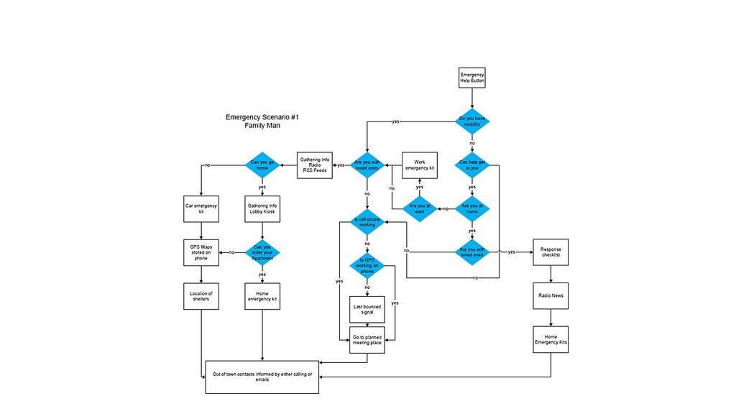
USER FLOW DIAGRAM

Slide 9
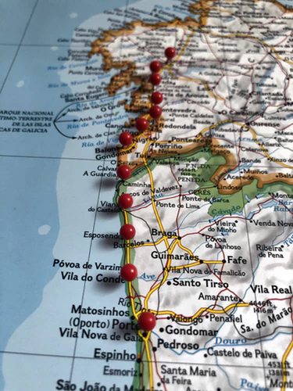
User Flow Diagram
After we have a good idea of how the user interface is going to look we want to figure out how users are going to interact with it. This is where the User Diagram comes into play. Here are a couple of questions to ask yourself when building a user flow diagram
How will users get to the form you are creating?
What do you want the form to ask?
Can users interact with data in any way?
What data do you want to collect?
Take 20 minutes to create a User Flow Diagram

Slide 10

Prototyping

Slide 11
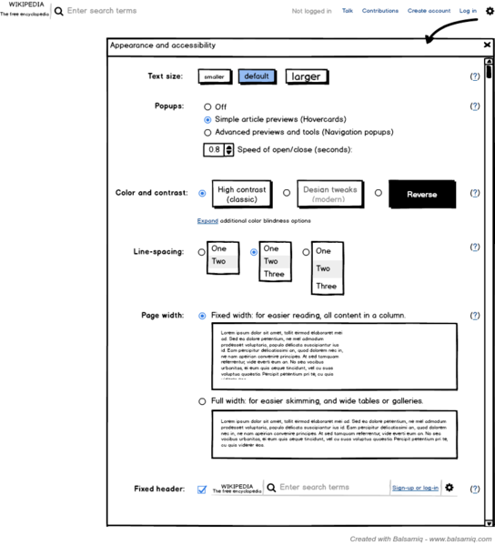
Wireframing
There are a couple of ways that you can prototype, the most popular way to prototype is to create a wireframe that gives you the building blocks of what your design is going to look like. Here are some questions you should ask yourself while wireframing:
Are there going to be any popups that you have to design?
What are the colors and the contrast?
What line spacing are you going to use?
Is there going to be a fixed header?
Did you miss anything?

Slide 12

Style guides &Typography
Notes:
In order to show that the current class parrot needs to inherit the properties of Bird we would use the keyword extend.
The Keyword extend allows us to pull the propperties of the previous class.

Slide 13
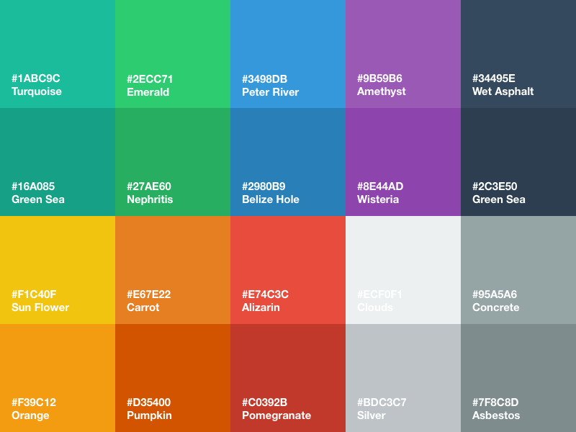
Style Guides & Typography
Another form of prototyping is to create a style guide that outlines the color, look and font styles you will be using for your design. A couple of questions to ask yourself while designing a Style Guide is:
What are the colors I am going to use?
What font style works with y form?
What is the font size going to be ?
Take 30 minutes to create a style guide and Mock up your form

Slide 14
Quick Questions
When would you use a Style Guide and when would you use a wireframe?
What kind of fonts do you want to stay away from when picking Typography
What is the purpose of a mockup?
What is a User Flow Diagram?

Slide 15
Q&A

Slide 16


